Slide 1
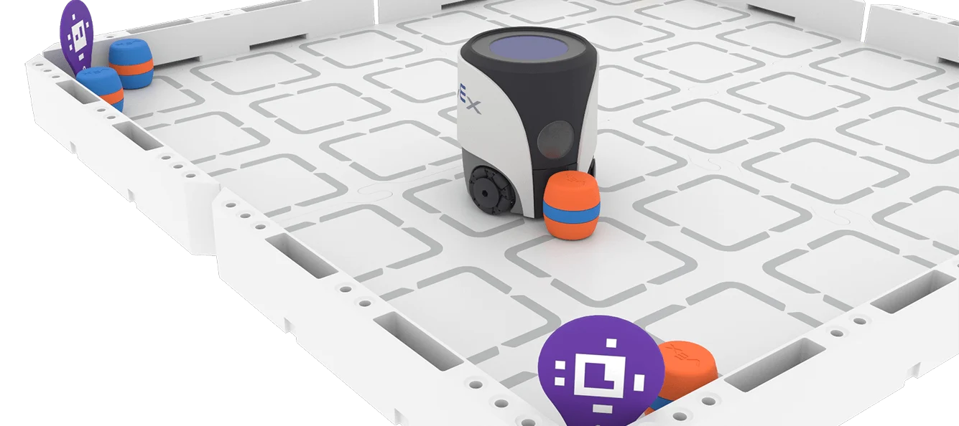
RECORDING MY LEARNING JOURNEY
STUDENT NAME: HAZEL W
YEAR 9 STEM DIGITAL
PORTFOLIO

Slide 2
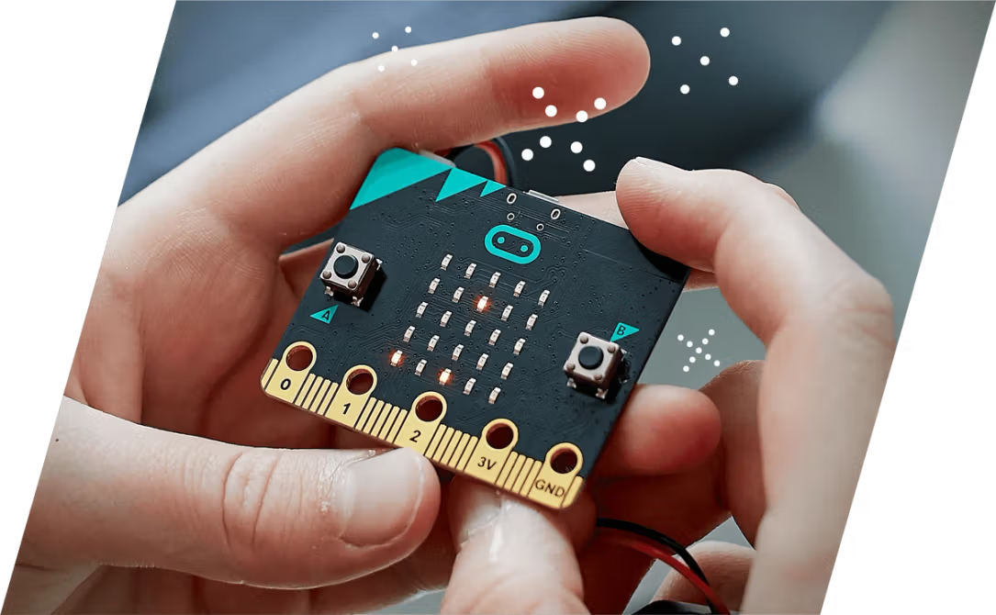
MY ROBOTICS EXPERIENCE
Have you used robots, coding platforms, or block-based programming before? Describe any experience — even playing games or using apps counts!
- I used some robots in primary school, and at my last school we did coding but I don’t remember what we did it on.
We used robots as bit in primary school, just some little circle ones, and we did coding in primary school too, and a bit in my last school but I don’t remember what they were on.

Slide 3

WHAT I HOPE TO LEARN
Write 2–3 goals you have for this robotics unit. What skills, concepts, or experiences are you most excited about? What do you want to be able to do by the end?
✏️ [Your response here]
I hope to learn more about coding, and to make a good virtual world.

Slide 4

UNIT GUIDE
HOW TO USE EACH UNIT
WHAT YOU WILL DOCUMENT
TIPS FOR SUCCESS
Each unit slide includes the same prompts to help you document your learning consistently. Fill in each section as you work through the unit activities.
Delete the prompts once each section is completed.
Add more slides as required.
Each unit includes: What I Learned, Key Vocabulary (3-5 terms), Code & Programming Notes, Challenges & Solutions, Pros & Cons, and Reflection Questions. Complete each section after finishing the unit activities.
Use your own words. Include screenshots or sketches where possible. Be honest in your reflections. Ask your teacher if you are unsure what to write in any section.

Slide 5
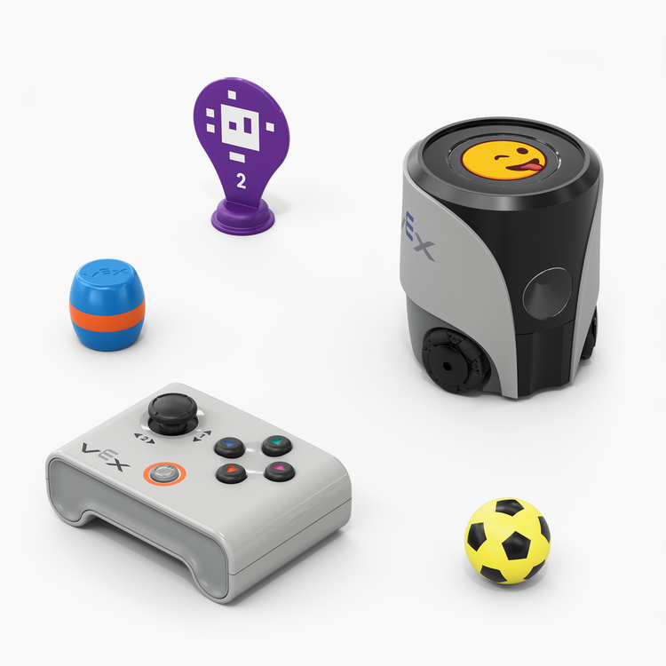
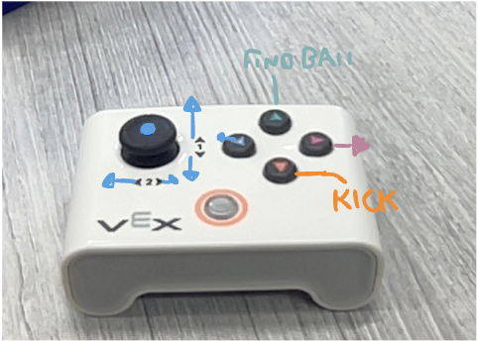
UNIT 1 – DRIVE WITH A CONTROLLER
Add an annotated image of the remote that explains how to use it.
CHALLENGES & SOLUTIONS
What difficulties did you face? How did you overcome them?
I don’t think there were very many difficulties with using the controller.
PROS & CONS OF USING A REMOTE
Pros: I like the remote because it’s very simple to use and you can change direction and move immediately without having to do a code.
Cons: Personally I don’t think there are any cons.
REFLECTION
What surprised you most about driving the robot? What would you do differently next time?
WHAT I LEARNED
Describe the key concepts you explored in this unit. How does the VEX AIM robot respond to controller inputs? What did you discover about driving and directional control?
KEY VOCABULARY
  ___________________ 2. ___________________
  ___________________ 4. ___________________

Slide 6
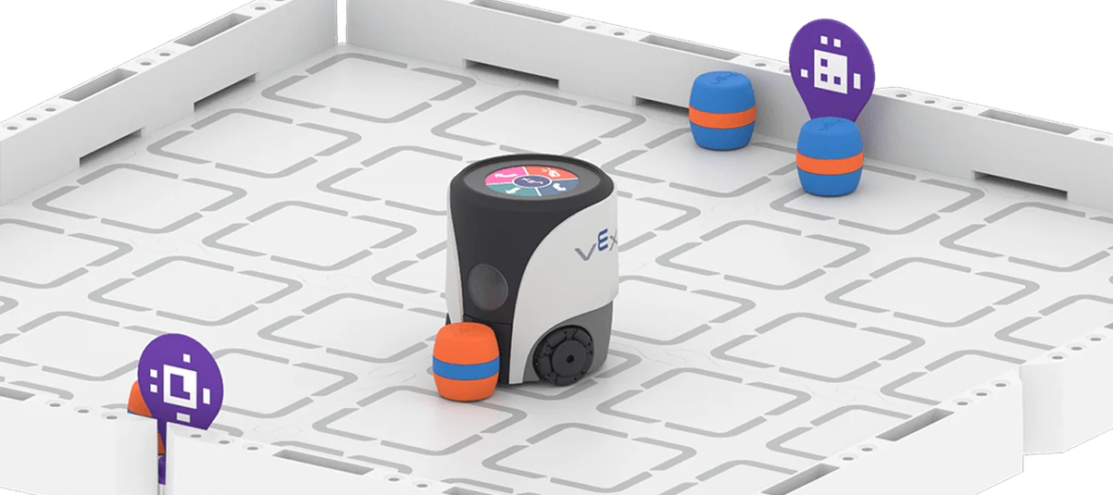
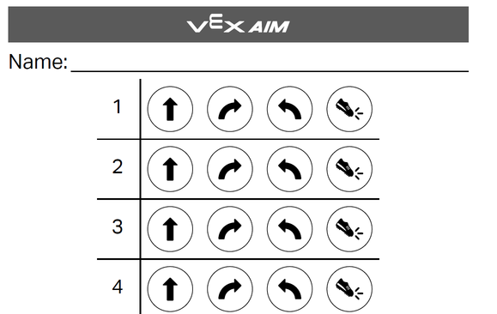
UNIT 2 – TOUCH TO CODE
WHAT I LEARNED
Describe the key concepts from this unit:
• How button inputs trigger robot movement commands
• How to sequence commands using button coding logic
• How the robot responds to different button signals
KEY VOCABULARY
• Button Event / Trigger:
• Command Sequence:
CODE / PROGRAMMING NOTES
Sketch or describe your button coding program below:
• Button used:
• Robot action triggered:
• Planning notes / sequence diagram:
CHALLENGES & SOLUTIONS
• Challenge I faced:
• How I solved it:
REFLECTION
• What surprised me about button coding?
• How did planning my sequence help?
• What would I improve next time?
PROS & CONS OF BUTTON CODING
Button coding was fun, but I don’t like how if you make one mistake you have to completely restart.

Slide 7
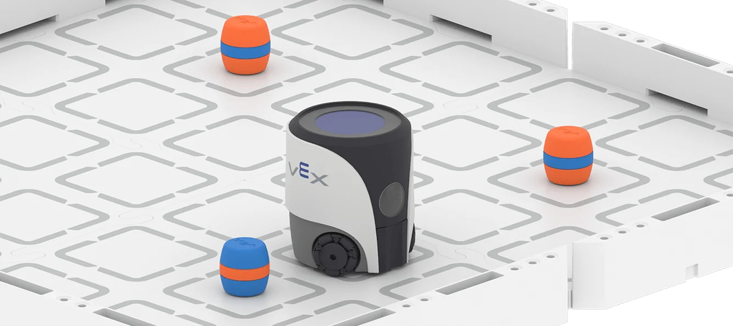
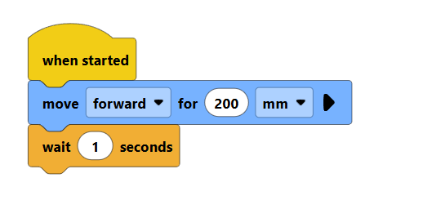
UNIT 3 – MOVE AROUND OBSTACLES
WHAT I LEARNED
Describe how block coding was used to program the robot to detect and navigate around obstacles. What movement commands did you use? How did the robot "decide" when to turn or stop?
KEY VOCABULARY
• Block code • Obstacle detection • Loop • Conditional • Sensor input
CODE / PROGRAMMING NOTES
Sketch or describe your block code sequence below. Which blocks did you use to move, detect, and avoid obstacles? Note any key logic or order of steps.
PROS & CONS OF BLOCK CODING
Pros: Block coding was a lot easier when you had to edit things compared to button coding.
Cons: I still prefer the controller because it’s very simple.
CHALLENGES & SOLUTIONS
Describe one difficulty you faced and how you solved it.
I don’t think there was any real challenges.

Slide 8
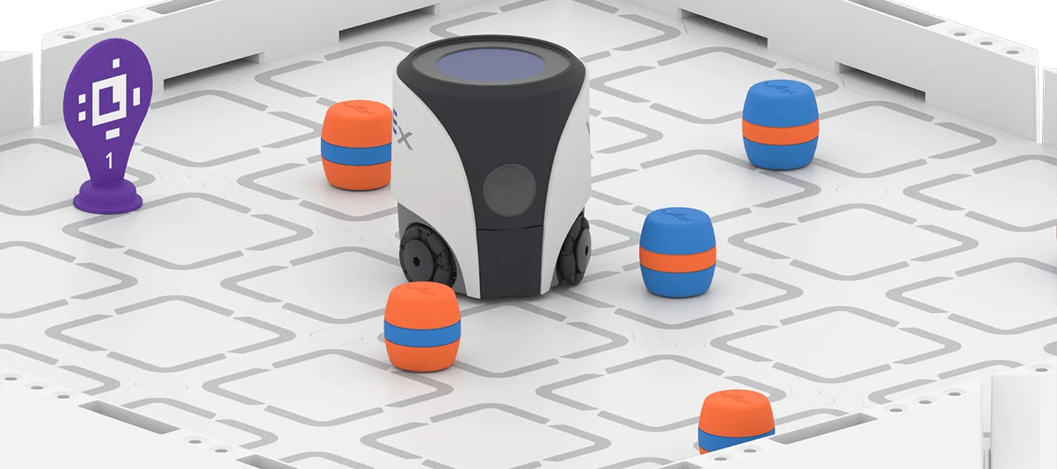
UNIT 4 – NAVIGATE DIAGONAL PATHS
WHAT I LEARNED
Describe the key concepts from this unit. How does the VEX AIM robot navigate diagonal paths? What block coding commands did you use to control direction and movement angles?
KEY VOCABULARY
• Diagonal movement:
• Heading/direction block:
• Angle/degree:
• Path planning:
• Coordinate navigation:
REFLECTION
• What surprised you about navigating diagonal paths?
• How did block coding help you plan the robot's route?
• What would you change or improve in your code next time?
CODE / PROGRAMMING NOTES
Sketch or describe your block code sequence for diagonal movement. What blocks did you combine? What values did you use for angles or headings?
CHALLENGES & SOLUTIONS
What difficulties did you face when coding diagonal paths? How did you solve them?
the angles had to be very precise when doing a diagonal path but the lines on the grid helped.

Slide 9
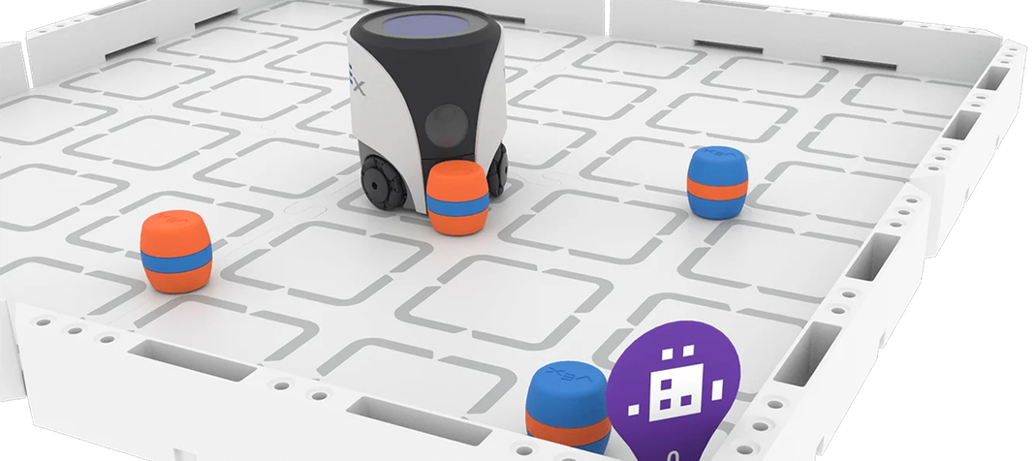
UNIT 5 – TRANSPORT CARGO
WHAT I LEARNED
Describe what you discovered about using 'turn to heading' blocks to navigate the robot. How does the heading system work?
KEY VOCABULARY
• Turn to Heading
• Absolute Heading
• Degrees / Direction
• Cargo / Payload
• Navigation Path
CODE / PROGRAMMING NOTES
Sketch or describe your heading-based program below. What heading values did you use to transport cargo successfully?
CHALLENGES & SOLUTIONS
What went wrong? How did you fix it?
I don’t really like using the headings, for me it’s a bit too confusing. But i liked how it made the robot face where it was going. But an advantage is that then you are able to actually interact with the objects, but it also required a little bit extra to get it to interact.
a few times we accidently typed the heading in wrong which made it go the completely wrong direction, but using comment blocks help to tell which part of the code is needed to fix
PROS & CONS OF TURN TO HEADING
Pros: ________________________________
Cons: ________________________________
REFLECTION
How did using headings make your program more precise? What would you improve?

Slide 10
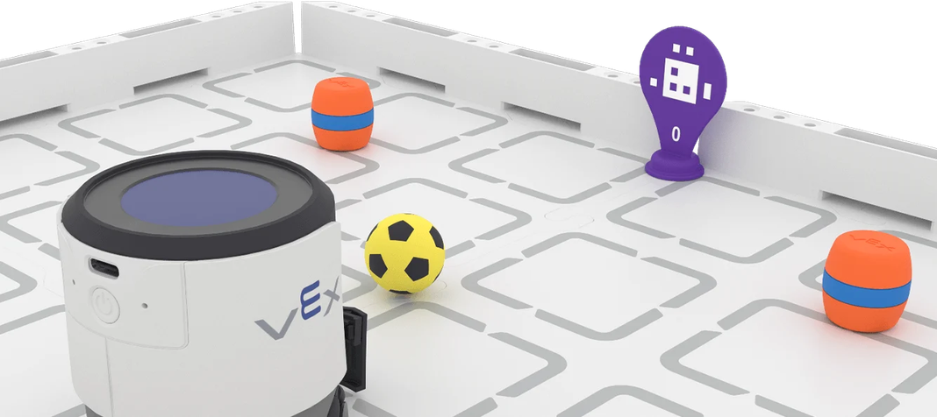
UNIT 6 – FINDING & TRANSPORTING CARGO
WHAT I LEARNED
Describe how the VEX AIM robot uses AI Vision to locate and transport cargo autonomously. What commands or blocks did you use to detect objects and navigate toward them? How did the robot decide when to pick up or move cargo?
KEY VOCABULARY
List 3–5 important terms (e.g., AI Vision sensor, autonomous navigation, object detection, pathfinding, cargo transport):
1.
2.
3.
4.
5.
I prefer the manual control because for me it’s easier but the AI vision sensor is still useful because it can find and go to the objects super easily without much help.
CODING STRATEGIES & PROGRAM NOTES
Sketch or describe your program logic below. How did you structure your code to find and transport cargo? What sensor inputs triggered each action?
CHALLENGES & SOLUTIONS
What difficulties did you encounter with the AI Vision sensor or cargo transport? How did you solve them?
REFLECTION QUESTIONS
• How does autonomous navigation differ from manual control?
• What factors affected the AI Vision sensor's accuracy?
• What improvements would you make to your program?
• What did this unit teach you about real-world robotics?

Slide 11
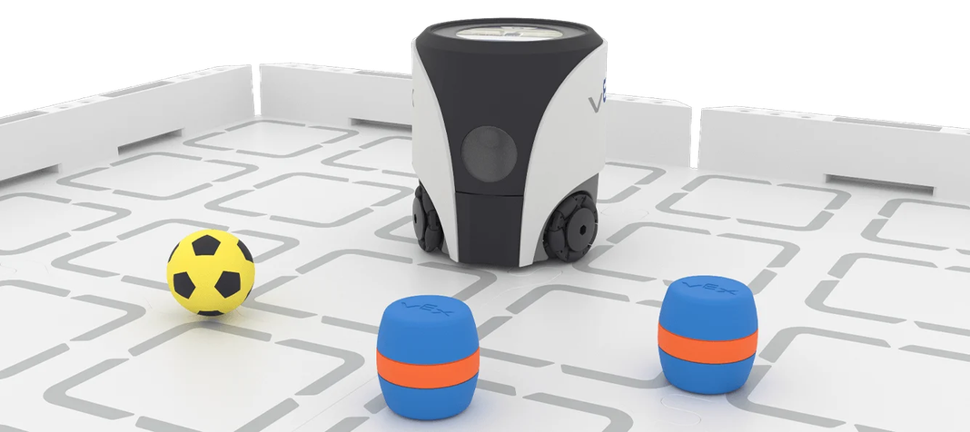
UNIT 7 – EXPLORING AI VISION
WHAT I LEARNED
Describe how the VEX AIM robot's AI Vision sensor works and what it can detect.
KEY VOCABULARY
• AI Vision Sensor
• Light sensitivity
• Detection threshold
• Environmental variable
• Sensor calibration
INVESTIGATION STEPS
Document your steps here:
FINDINGS & REFLECTION
How did light and other factors impact the AI Vision sensor?
What changes improved sensor accuracy?
What would you test next time?
I think the AI vision sensor is pretty cool that it can recognise what it is looking at and then do different colours and emoji’s for each object, but it took a few goes before I got the code right.

Slide 12
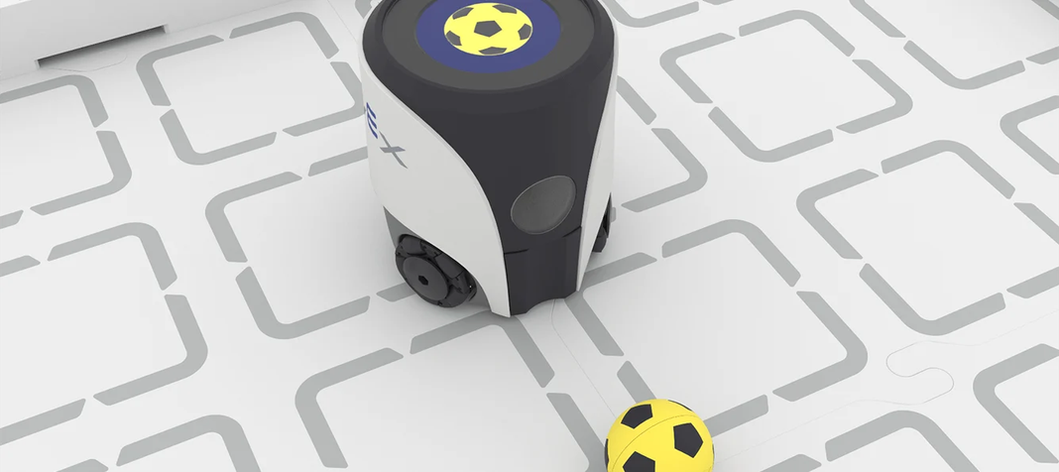
UNIT 8 – CONTROLLING DECISIONS
What I Learned:
Describe how you used conditional logic and decision-making in your code. How did the robot "decide" what action to take based on sensor input or conditions?
Key Vocabulary:
List 3–5 important terms (e.g., conditional, if/else, Boolean, sensor trigger, decision tree)
Code / Programming Notes:
Sketch or describe the decision-making logic you programmed. What conditions did you set? What actions followed each condition?
Capstone Preparation Reflection:
How does controlling decisions connect to the Delivery Dash challenge? Which skills from Units 1–7 will you integrate? What is your biggest strength going into the capstone?

Slide 13

DELIVERY DASH
CAPSTONE CHALLENGE – PLANNING
Project Goal:
My Approach / Strategy:
Steps I Plan to Take:
Resources / Code I Will Use:
Potential Challenges:

Slide 14
DELIVERY DASH
EXECUTION & CODING
Steps I took to complete the Delivery Dash:
Key coding highlights / snippets used:
RESULTS & REFLECTION
Outcomes & robot performance:
What went well:
Lessons learned & improvements for next time:

Slide 15
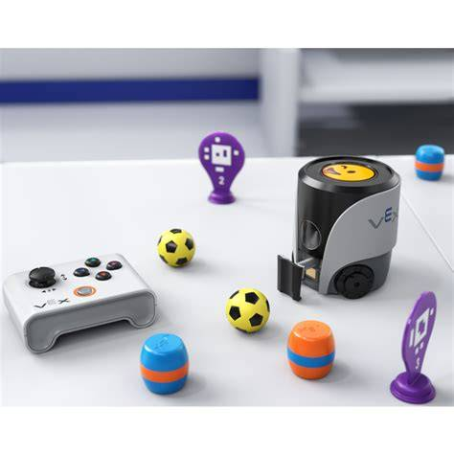
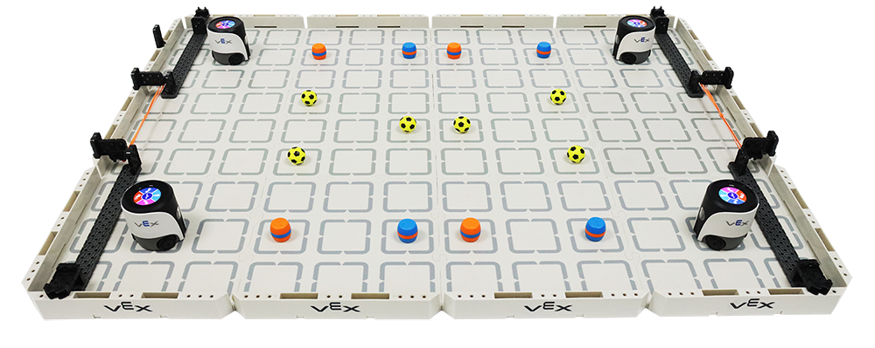
SHOWCASE PLANNING
DEMO ACTIVITY
MATERIALS NEEDED
Activity Description:
Demonstrate your VEX Aimbot robot to parents and visitors. Show how your robot navigates, avoids obstacles, and completes tasks using your chosen coding approach.
Step-by-Step Instructions:
  Set up the robot and arena
  Explain your coding method
  Run a live demonstration
  Invite visitors to try the controller
  Answer questions about your learning
Materials Checklist:
• VEX Aimbot robot (charged)
• Remote controller
• Laptop with VEX coding environment
• Arena/obstacle course setup
• Printed program or cue cards
Expected Learning Outcomes:
Visitors will understand how students use block code, AI vision, and remote control to program autonomous and manual robot behaviours in real-world challenges.

Slide 16

SHOWCASE CODING OPTIONS
REMOTES: MANUAL CONTROL
BUTTON CODING: INTERACTIVE TRIGGERS
BLOCK CODE: AUTOMATED SCRIPTS
Use a controller to drive the robot live during the demo. Great for showing visitors how to steer and interact with the robot in real time. Simple, engaging, and easy to explain to parents and guests.
Program specific buttons to trigger robot actions. Visitors can press a button and watch the robot respond. A great way to show how simple inputs create programmed outputs and introduce coding logic.
Set up a fully automated sequence using block code. The robot runs a pre-programmed routine independently. Ideal for demonstrating autonomous navigation, obstacle avoidance, or cargo transport without manual input.

Slide 17
OVERALL UNIT REFLECTION
MY LEARNING SUMMARY
🏆 My biggest achievement:
💡 Challenges I overcame:
🤖 How my understanding improved:
🚀 Skills I'll take forward:

Slide 18


